Slide 1
Evaluation and recast of EU water policies Status, challenges and lessons learnt
2019 Danube Conference
Vienna - May 21st 2019
Michel Sponar– DG Environment, European Commission

Slide 2
What is ongoing in the water area?
Groundwater Directive
2 Daughter Directives
Environmental Quality Standards Directives
Strategic approach to pharmaceuticals in the environment
Floods Directive
Urban Waste Water Treatment Directive
Water Framework Directive (WFD)
Other related instruments:
Marine Strategy Framework Directive
Plastics Strategy
Industrial Emissions Directive
…
Nitrates Directive, Sewage Sludge Directive, Bathing Water Directive
Basic measures
Water re-use Regulation
(Recast)
Drinking Water Directive
Under Evaluation
EC proposal
Recently adopted

Slide 3
Current Drinking Water Directive
"Protect human health from adverse effects of any contamination of water intended for human consumption"
Monitoring and remedial action:
48 parameters based on WHO
Information to consumers
Reporting to COM

Slide 4
What's new?
Updated parameters
Increased transparency
Risk-based approach
Access to water
Highest quality standards for materials in contact

Slide 5
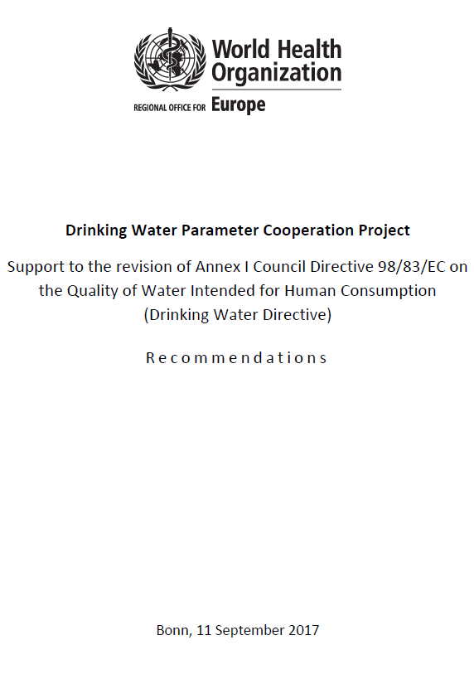
Cooperation with WHO

Slide 6
Risk-based approach
Point of compliance
Catchment area
(also WFD)
Treatment
Drinking Water Distribution
Consumer
OLD
Abstraction
Supply
Distribution
Consumer
NEW
Proposal covers complete
water supply chain

Slide 7
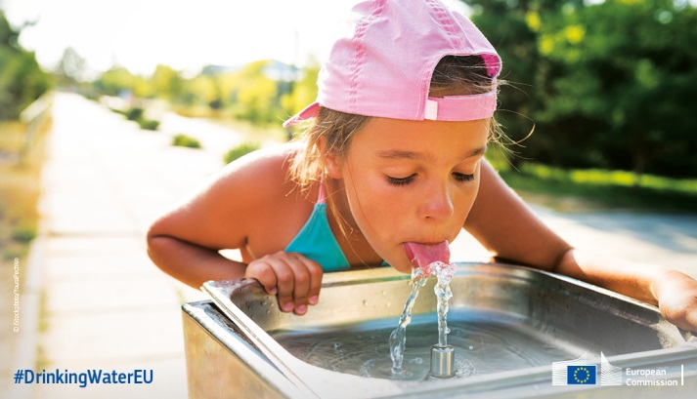
Art. 13 on access to water
Measures to ensure access to water for vulnerable and marginalised groups
Measures to improve access to tap water: encourage to build infrastructure, free access in public spaces, campaigns …

Slide 8
Perspectives for Trilogues
Standards
Materials in contact with water
Access to water
Transparency

Slide 9
Current Urban Waste Water Directive
Evaluation: Objective
Objective: “Protection of the environment from the adverse effects of the discharges of untreated waste water”
Collection
Agglomerations > 2000 p.e.
Alternative: Individual and other appropriate systems
Treatment
Secondary treatment = minimum
Monitoring and reporting
Performance of treatment plants
Sensitive areas: more stringent treatment (discharge > 10 000 p.e.)
Biennial reporting to EC

Slide 10
What has worked and what has not?
Evaluation: Objective
Effective-ness
(objectives achieved?)
EU-added value
(useful to act at EU level?)
Efficiency
(costs vs benefits)
Better Regulation
Relevance
(still needed today?)
Coherence
(internally & with other EU law)

Slide 11
Methodology
Evaluation: Objective
Key issues
Literature review
Put
Modelling (JRC)
EEA inputs
OECD/
ENV
Stakeholder input

Slide 12
Implementation
Compliance rates | Article 3 (collection) | Article 4 (secondary treatment) | Article 5 (more stringent treatment)
EU 15 | 98.8% | 90.6% | 82.7%
EU 13 | 76.3% | 73.1% | 64.8%
EU 28 | 95.1% | 88.0% | 75.6%
Distance to target | Collection | Secondary treatment | More stringent treatment
EU 15 | 0.2% | 5.6% | 13.8%
EU 13 | 5.7% | 10.3% | 18.4%
EU 28 | 1.1% | 6.3% | 15.6%
Source: 10th EU report on the implementation of the directive, 2016 data

Slide 13
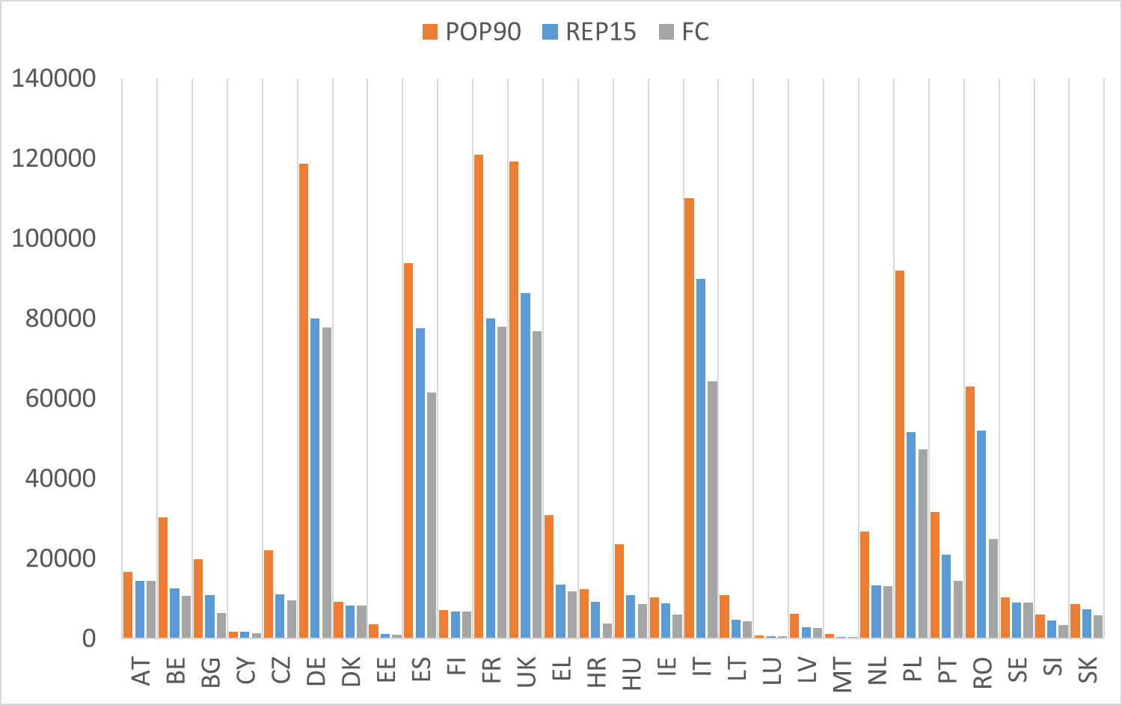
Effectiveness
1990
Today
Full compliance
Reduction of BOD loads
tons/year (source: JRC- Modelling)

Slide 14
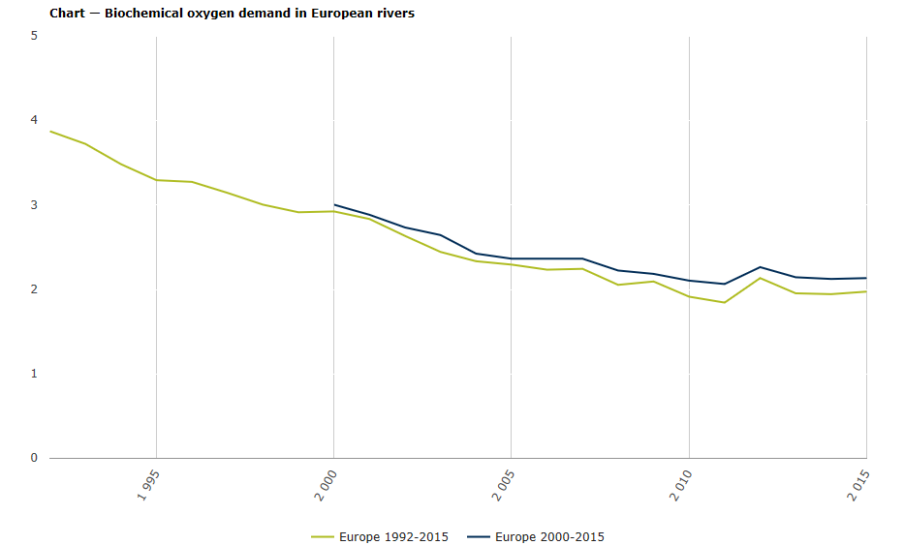
Effectiveness
BOD in European rivers
annual mean concentrations, based on monitored data – Source EEA
Notes:
Concentrations are expressed as annual mean concentrations. Only complete series after inter/extrapolation are included (see indicator specification). Two time series are depicted – the longer time series with less stations and the shorter time series with more stations. The number of river monitoring stations included per country is given in parenthesis. BOD7 data has been recalculated into BOD5 data.
EEA https://www.eea.europa.eu/data-and-maps/indicators/oxygen-consuming-substances-in-rivers/oxygen-consuming-substances-in-rivers-8

Slide 15
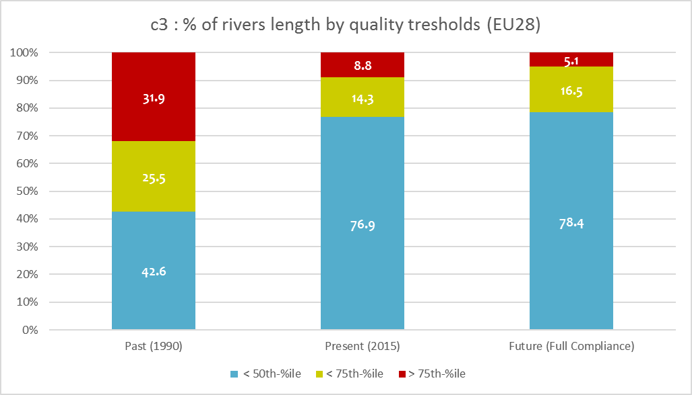
Effectiveness(beyond targets)
Source: JRC 2019
metachemical c#3, e.g. estrone (E1), estradiol (E2), Bisphenol A

Slide 16
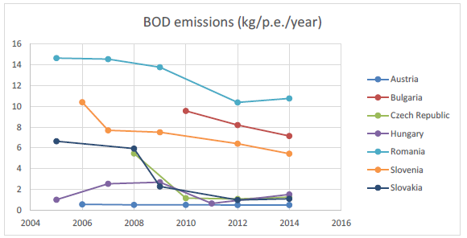
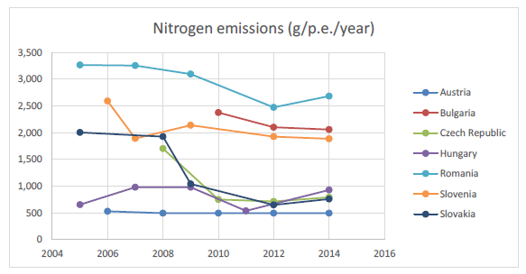
Effectiveness -Danube

Slide 17
Not all is perfect …
Overall right parameters are covered, but:
COD methodology = based on a SVCH.
No adaptation to changing external factors/technologies
Lack of representativeness of the sampling (frequency)
Monitoring
Overall effective for main purpose = monitoring implementation progress and SIIF was step forward, but:
Information not made available very quickly
Some information not comparable (e.g. on investments).
Reporting
Information to the public
Very limited obligations under UWWTD
Public is interested in information on UWW
More information could help facilitate way forward

Slide 18
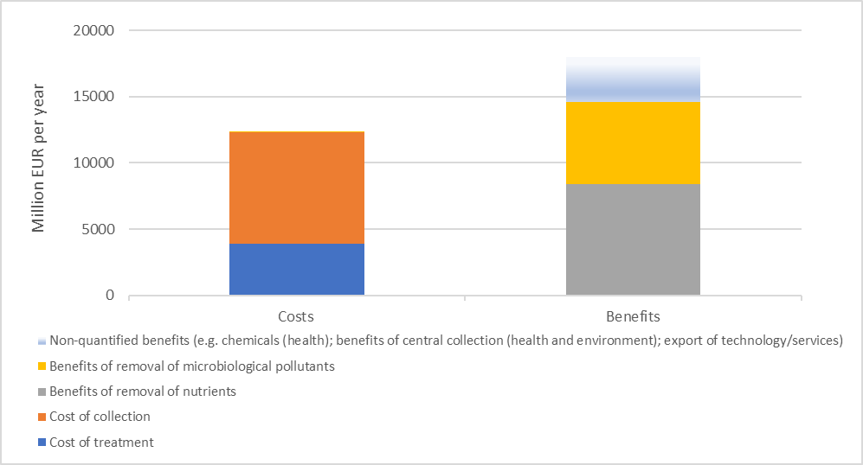
Efficiency
Source: Wood 2019

Slide 19
Efficiency
2011-15 annual average, source : OECD 2019

Slide 20
Efficiency
Share of EU transfers in estimated total expenditures for WSS per country
2011-15 annual average, source : OECD 2019

Slide 21
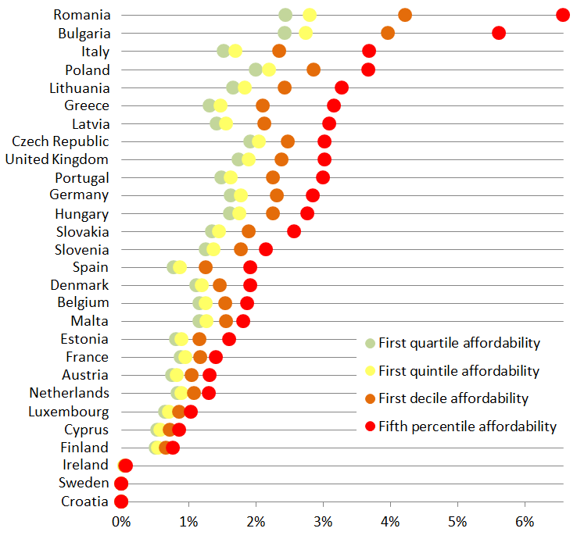
Efficiency - Affordability
Source: OECD 2019 – Preliminary results

Slide 22
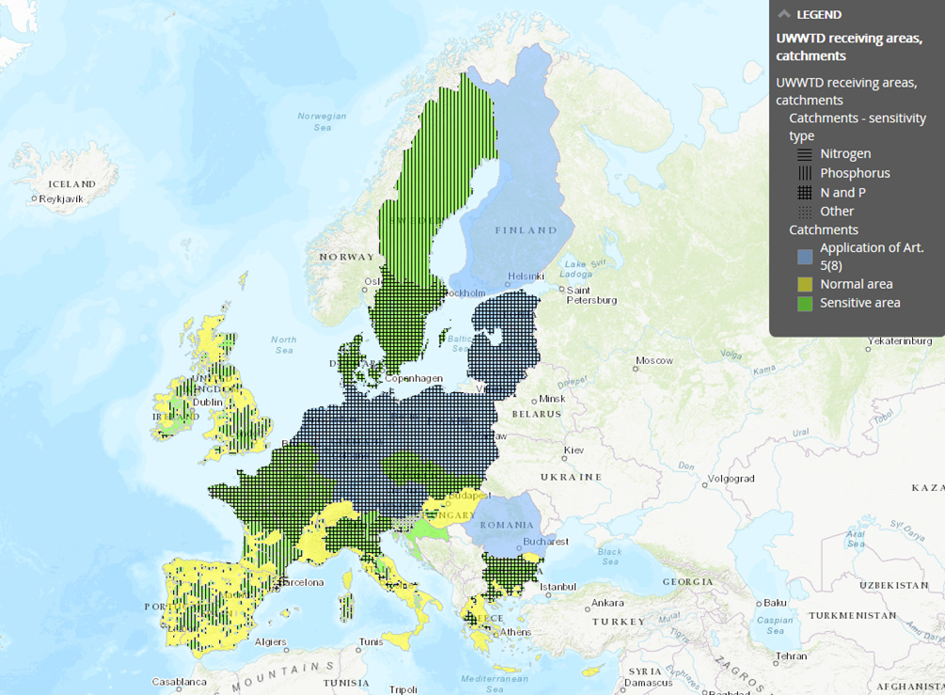
Coherence - Sensitive areas
Notes:
Few unclear terms and definitions
1 diverging threshold
No link to Annex ID in Art. 4 and 5
Overall good coherence (with WFD, ND, SSD, FD)
Potential minor issues with IED and E-PRTR
Potential for further alignment with energy/climate law
On national levels: urban planning and procurement issues
Little evidence on before/after status
MS do not always assign in the same way.
Unclear how links between UWWTD, ND, WFD and MSFD work for assessment

Slide 23
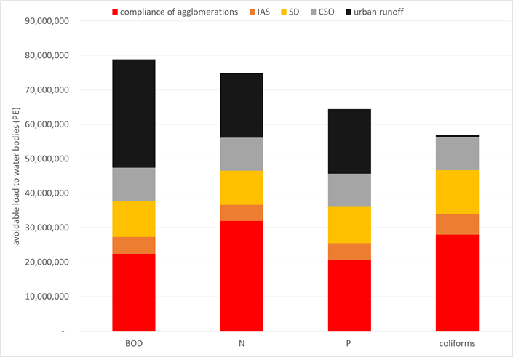
Relevance -Remaining loads
Source: JRC 2019

Slide 24
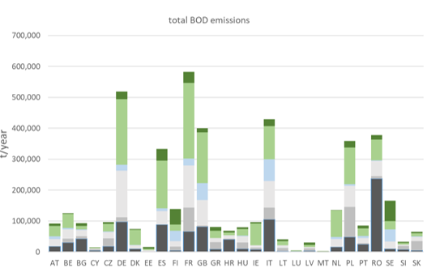
Contextualisation
Source: JRC 2019

Slide 25
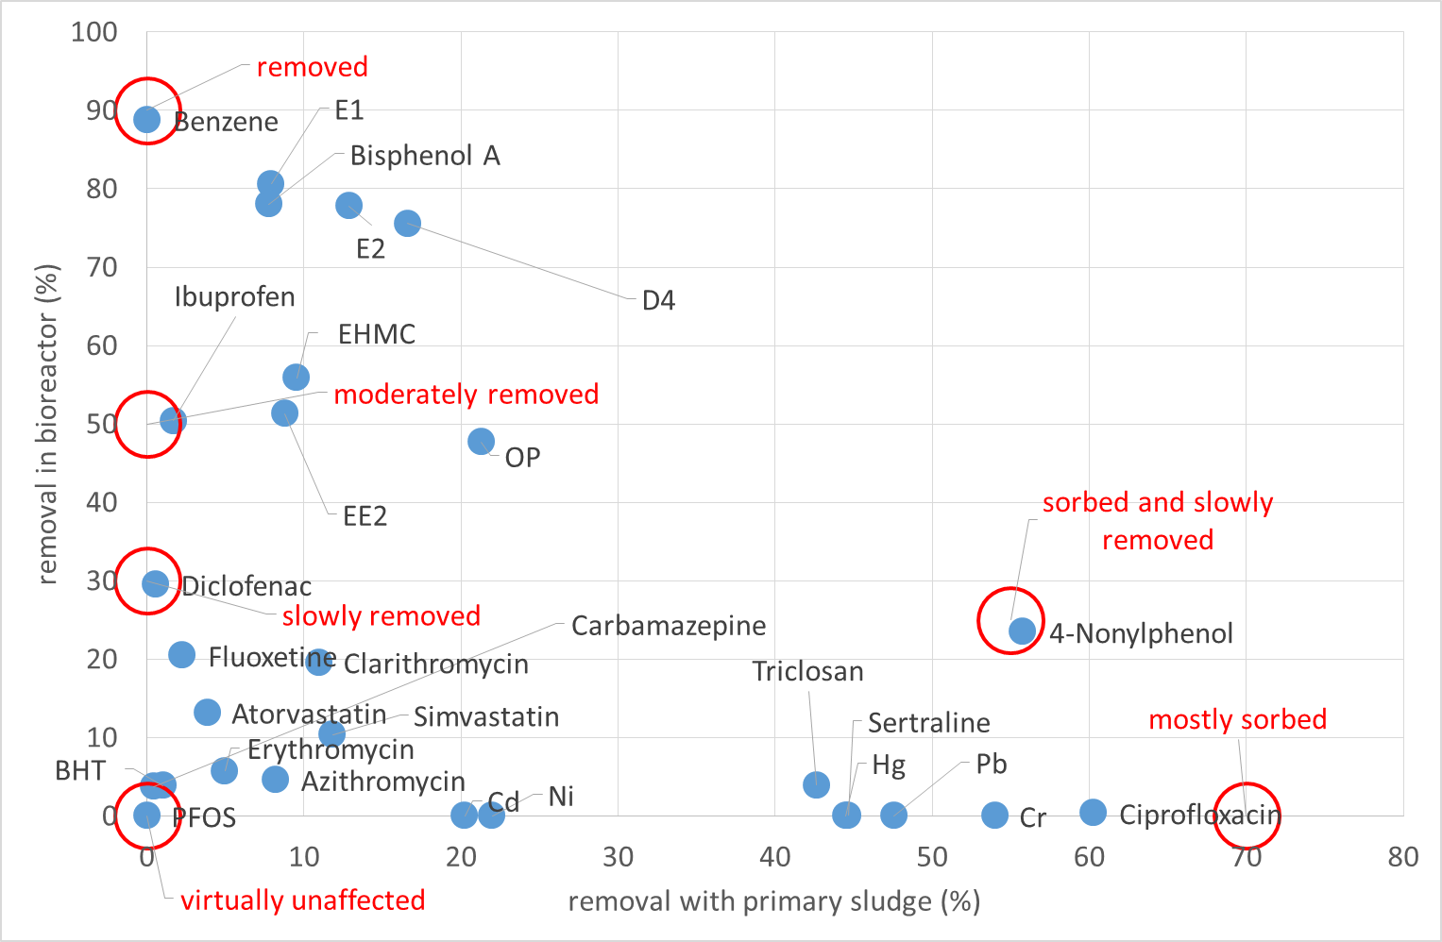
Relevance - Chemicals
Source: JRC 2019

Slide 26
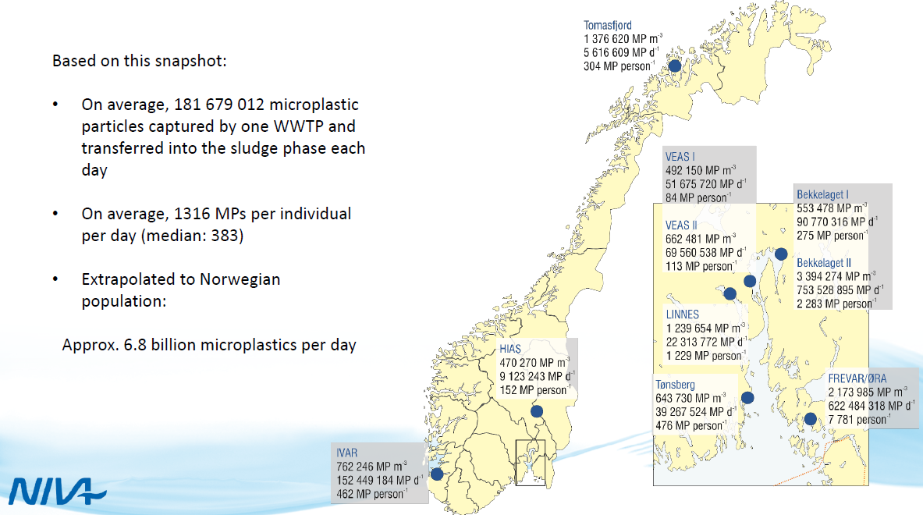
Relevance - Microplastics
Source: NIVA 2018

Slide 27
Resource efficiency
Energy use and generation
Sludge re-use
Water re-use
High use,
Potential for carbon neutrality
… difficult
...
EC proposal for Regulation on water re-use

Slide 28
Main lesson learnt
Directive has delivered – high level of implementation, huge reduction of loads from targeted sources, actual effect on aquatic environment
Benefits higher than costs – despite impossibility to monetize all benefits
Directive was one of the first regulating pollutants releases (1991) - therefore high level of coherence with subsequent legislation
Directive still relevant and EU added value is clear – domestic/urban pollution will continue and has to be treated at the level of basins – EU legislation supports that

Slide 29
Main lesson learnt
Reasons of success:
Simple, clear and focused legislation
EU carrot and stick approach - Infringement combined with EU funds
Barriers:
In some MS too optimistic deadlines due to lack of serious planning/+assessment of the impacts
Governance – disconnection between National and local authorities
Lack of political will

Slide 30
Challenges
Local vs European
Remaining sources – full implementation, overflows, IAS, urban run off, < 2000 eq/inhab
Pharmaceuticals, micro plastics and sludge management
(re)Investments needs, financial sustainability, planning and affordability
Energy use and climate change…

Slide 31
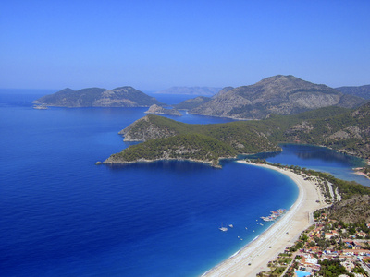
Thank you for your attention!

